Slide 1
Community Planning & the
Built Environment
Shaping what our community looks like!
Notes:
‹#›
Slide for educator

Slide 2
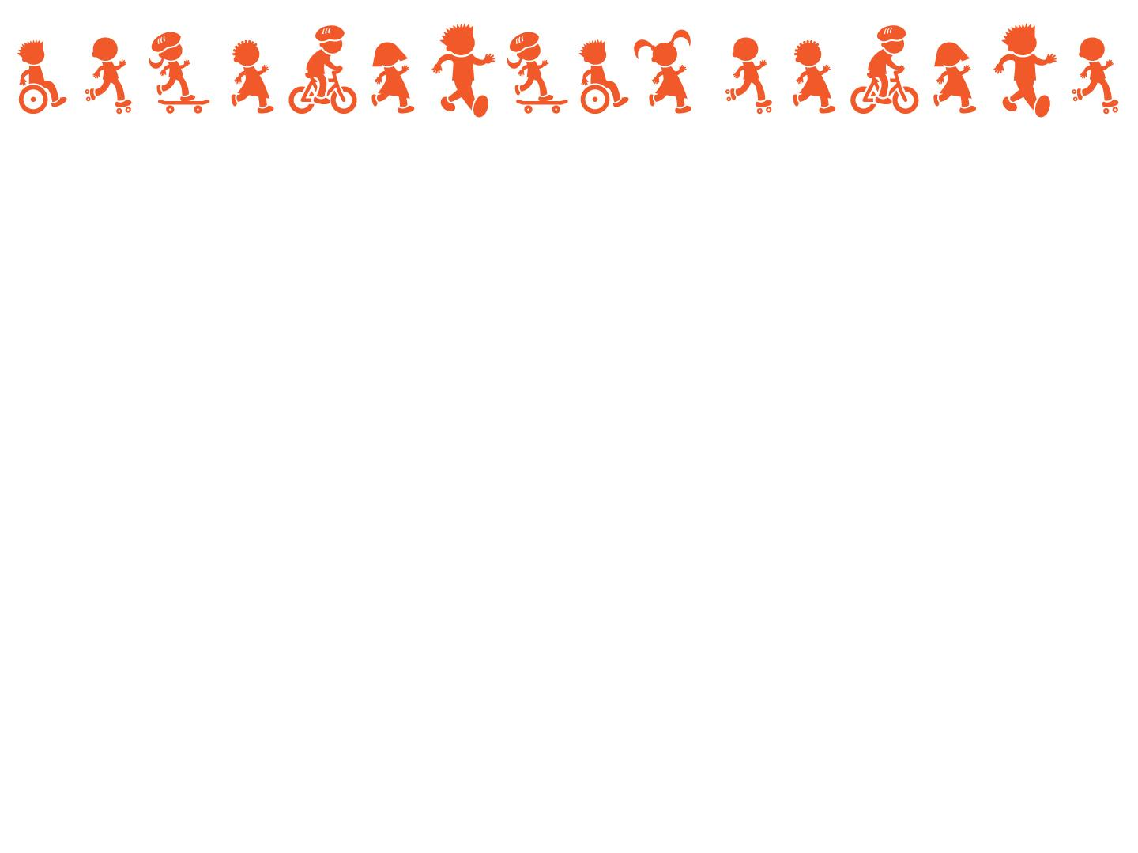
Letter to Educators
With the guidance of teachers throughout the East Central Wisconsin region, the East Central Wisconsin Regional Planning Commission team is proud to offer you Community Planning & Built Environment Lesson Plans, created for students in grades 5-7.
The lesson plans teach students how community leaders and residents make decisions about the built environment. The lesson plans focus on active transportation, and how transportation planning relates to the way they get around their communities. As informed and aware community members, students can understand how their communities come to look the way they do and can make informed decisions about how they get around.
Thank you for being part of this effort to make our communities safer and healthier!
Sincerely,
Your Safe Routes to School Team East Central Wisconsin Regional Planning Commission
Notes:
‹#›
Slide for educator

Slide 3
Lesson Plan Goals
Teach students how community and active transportation decisions affect the built environment.
Convey to students how those decisions affect their travel patterns and their health and wellbeing.
Show students how to observe their built environment and empower them to make decisions about how they might improve it, particularly as it relates to their route to school.
Learning Standards
Applicable learning standards:
Environmental Literacy and Sustainability | Standards 1, 3, 5, 6, 7
Health | Standards 1, 2
Notes:
‹#›
Slide for educator

Slide 4
Lesson Overview & Learning Objectives
Day 1: Community & Transportation Planning
Learn about the relationship between the physical built environment and social environment. (Environmental Literacy and Sustainability, Standards 1, 2, 3)
Learn how decisions are made about the physical built environment through community and active transportation planning. (Environmental Literacy and Sustainability, Standards 1, 3, 5)
Day 2: Walk Audit (virtual or digital) & Route Planning
Learn how to observe the physical built environment and see how the built environment affects mobility, connectivity, access to resources, wellness, and transportation choices. (Environmental Literacy and Sustainability, Standards 1, 3, 6; Health Standards 1, 2)
Identify or compare built environment areas in the community that promote well-being and explain why. Discuss the impacts on society. (Environmental Literacy and Sustainability, Standards 1)
Apply the knowledge about the connection between the physical built environment, social environment, and planning to plan a route to school. (Environmental Literacy and Sustainability, Standards 1, 6)
Day 3: Class Presentations
Identify changes and processes for affecting change in their environment (Environmental Literacy and Sustainability, Standards 6, 7)
Notes:
‹#›
Slide for educator

Slide 5
Lesson Plan Instructions
Select the dates and times you would like to run the project.
Discuss with your principal if off-campus walk audits are feasible.
Reach out to the ECWRPC Safe Routes to School team to schedule your in-class presentation: [insert the contact email]
Check out the print and digital materials on [https://eastcentralsrts.org/URL]
Send home permission slips for students to participate in the Walk Audit [insert ECW link].
Notify families and the school community about the project using this Newsletter blurb [insert ECW link]
Implement the Lesson Plans
Notes:
‹#›
Slide for educator

Slide 6
Day 1: Community & Transportation Planning
Learning Objectives:
Learn about the relationship between the physical built environment and social environment. (Environmental Literacy and Sustainability, Standards 1, 2, 3)
Learn how decisions are made about the physical built environment through community and active transportation planning. (Environmental Literacy and Sustainability, Standards 1, 3, 5)
Logistics:
Time: 30 - 45 minutes
Location: Classroom
Materials:
Students need a sheet of paper on which they can take quick notes and reflections.
Vocabulary:
City planner
City engineer
Active transportation
Walkability
Bikeability
Notes:
‹#›
Slide for educator

Slide 7
Day 1: Community & Transportation Planning
Vocabulary Definitions:
City Planner: Someone who determines the best way to use a city’s land and resources.
City Engineer: Someone who designs and maintains infrastructure and systems.
Active Transportation: Active transportation includes ways of getting around that are healthy and active such as walking and biking, or “activity rolling” using skateboards, scooters, etc. that are human-powered. Active transportation includes using mobility aids, such as a wheelchair.
Walkability: how safe, comfortable, and convenient a place is to walk.
Bikeability: how safe, comfortable, and convenient a place is to bike.
Infrastructure: the resources and physical structures that support an activity or system. For this lesson, we refer to infrastructure as physical structures (roads, sidewalks, paths, bus stops, etc.) that can allow us to get around and connect with others.
Active Transportation Infrastructure: Active transportation infrastructure are the physical structures that support biking, walking, and/or rolling.
Redlining: the illegal, discriminatory practice of denying home loans to people based upon race. This practice targeted black homeowners in particular and denied them the ability to live in certain neighborhoods and, in many cases, the ability to become a homeowner.
Notes:
Slide for educator

Slide 8
Day 1
Community & Transportation Planning!
Did you know - a team of people planned out every neighborhood, street, sidewalk, crosswalk, and even your parks!?
Notes:
‹#›
Introduction to student-facing content

Slide 9
What is…
a neighborhood?
Who decides…
what goes there?
what it looks like?
Notes:
‹#›
Use the spacebar to activate the animation.
Speaking notes:
A neighborhood is any area or district within a town or city that forms a specific community.
Many professionals, community members, and local political leaders help decide what a neighborhood looks like and what “belongs” in a neighborhood. You can help shape what your neighborhood looks like and what your neighborhood provides your community. Let’s dig into this!

Slide 10
City / Regional Planner:
City / Regional
Engineer:
Someone who determines the best way to use a city’s land and resources.
Someone who designs and maintains infrastructure and systems.
Notes:
‹#›
Speaking notes:
Infrastructure refers to the resources and physical structures that support an activity or system. Infrastructure that a city / regional engineer could design and maintain includes roads, sidewalks, bridges, bike paths, highways, and trails, etc.

Slide 11
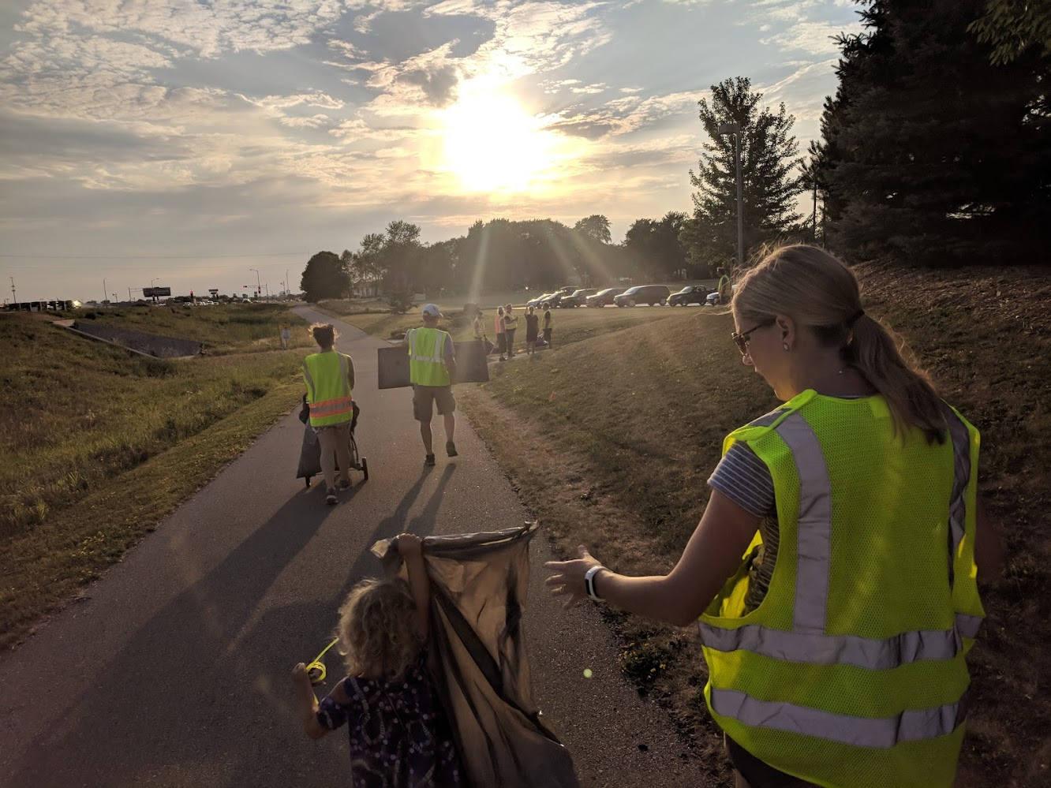
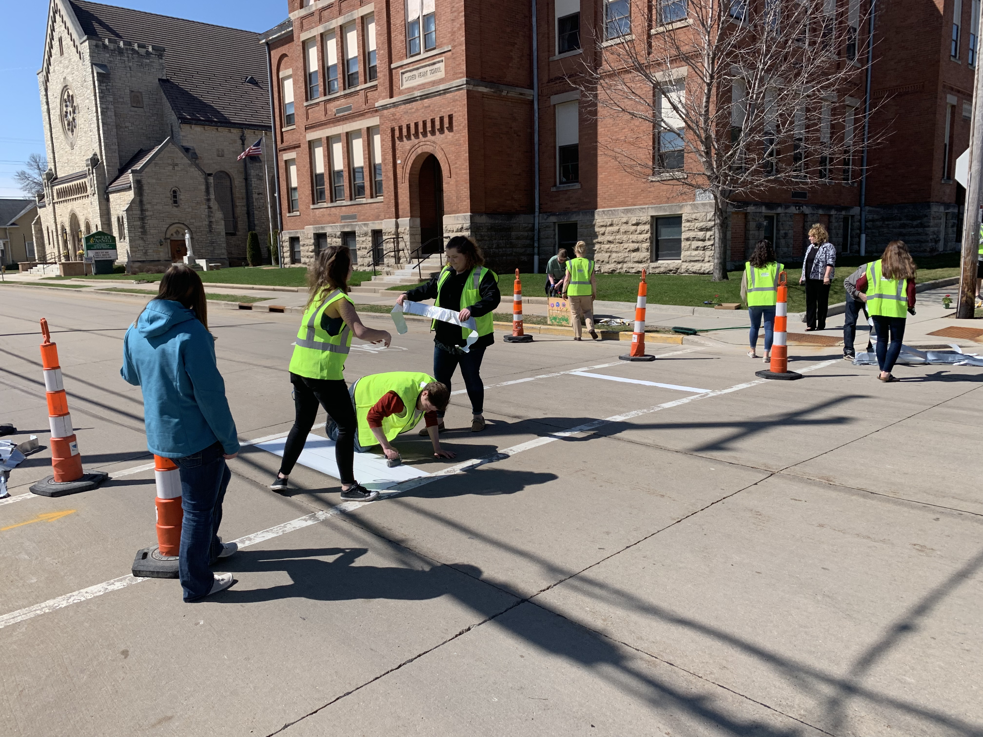
City / Regional
Planner
City /
Regional
Engineer
You! The
Community
Notes:
‹#›
Speaking notes:
Planners and engineers have specialized knowledge of how various pieces of a community can fit together and what they look like, but every community and neighborhood is different! The local community should be guiding the decisions that the planners and engineers make...because they (you!) know their community the best. You and your community can get involved in these decisions by attending public meetings, contacting public officials, or getting involved with a local group or organization that might already be involved!

Slide 12
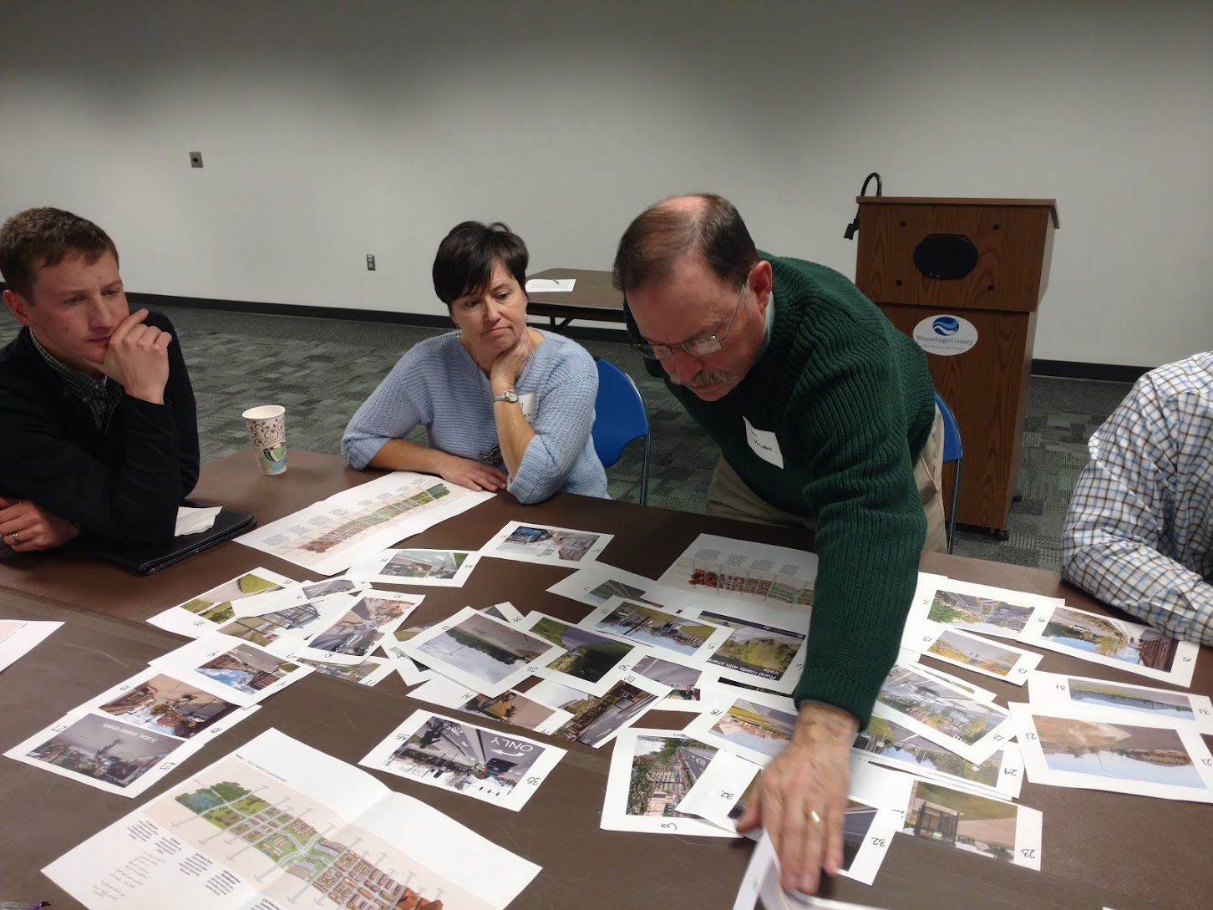
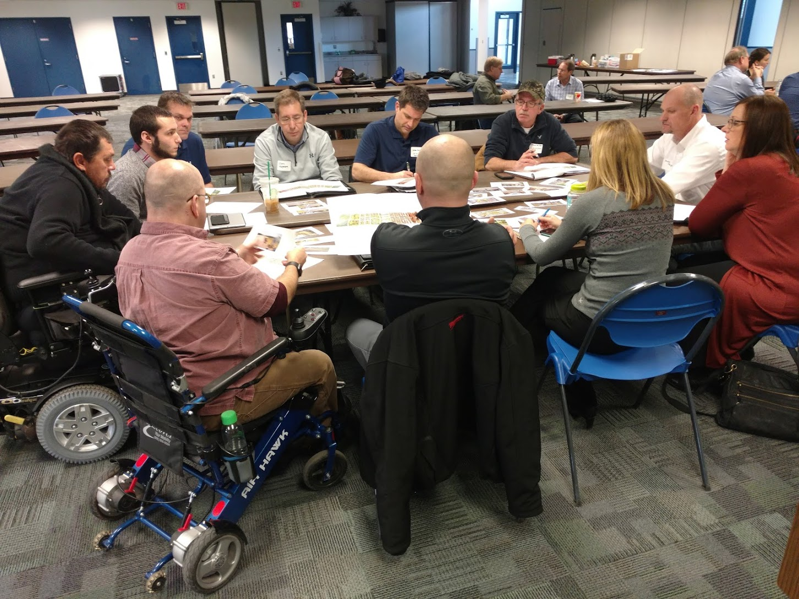
Planners & Engineers...
Determine how the pieces of our community fit together!
What are the “pieces of our community”?
Anything that is a building, road, or park...
Schools
Residential areas
Grocery stores, factories, and other businesses
Trails and bike paths
Types of parks
Number of lanes in a road
Bus routes and train tracks
www.planning.org/educators/whatisplanning/
Notes:
‹#›
Use the spacebar to activate the animation.
Speaking notes:
Our neighborhoods are ecosystems -- planners and engineers work together to help fit the pieces of a city, town, or neighborhood together.
What are the pieces of our community?
Discuss “system” of a city or town and how these pieces are in-relationship to each other:
A city/town is made up of neighborhoods. Each neighborhood is made up many pieces - such as streets, parks, schools, homes, and other places. How each of these pieces of a community are placed and connected can either help us make decisions that foster our physical health, social connection, and mental wellness. OR they can actually make those decisions a lot harder.

Slide 13
What does “best” mean?
What do you like about your neighborhood?
What is something in your neighborhood that makes you feel safe?
What do you dislike about your neighborhood?
Notes:
‹#›
Speaking notes:
We said that City or Regional Planners are professionals whose job it is to determine the best way to use a city or town’s land and resources.
Take a moment to jot down your thoughts to these questions on a piece of paper.
What do you think “best” means?
What do you like about your neighborhood? -- think about what makes your mind, spirit, and/or body feel good.
What is something in your neighborhood that makes you feel safe?
What do you dislike about your neighborhood?
Share out - using white board or another way to capture different students’ feedback.
See how we have common things that we like or make us feel safe, but we also like different things. It’s really important the community planners and engineers come from diverse backgrounds and engage with diverse community members to understand what everyone wants and needs... and then find the things in common and get creative with community members.

Slide 14
History of Community Planning
Historically, who have been the planners and engineers?
Who have they planned for? Whose voices from the community have they listened to?
Who has been left out or forced out? How has this history and these decisions affected people’s lives in the present?
Notes:
‹#›
Acknowledge how planning has wronged Black, Indigenous, and other communities of color. Consider small group discussions, the consciousness your students have of racial and ethnic disparities, and how students of color in your classroom are supported in these difficult conversations.
Speaking notes:
Because of our country’s history of racism, many communities were planned to keep Black, indigenous, and other people of color segregated from white people.
This was done by planners and engineers, along with politicians and the public, by not allowing Black, indigenous, and other families of color to purchase homes in certain neighborhoods, by bulldozing homes of black and brown families to build train tracks and highways, keeping these families separated from other parts of a community, including grocery stores, health clinics, and parks. Instead, many of these families were forced to live next to factories and polluted areas, which affected many people’s health outcomes for generations. This practice was called red lining - the illegal, discriminatory practice of denying home loans to people based upon race.
The harm that these policies and community planning efforts created is not okay.
It’s important that we all help to shape our neighborhoods and voice what we need to live healthy lives. -- for ourselves and each other -- especially those who have been harmed the most. When we give feedback to our city planners/engineers, we want to make sure other people who haven’t been listened to are having the chance to give their feedback and being listened to, too. That way, a planner or engineer can make the best decisions -- with our input!
One additional way we can ground ourselves and remind ourselves of injustice so that we can do better is to say and honor a Land Acknowledgement. An Indigenous land acknowledgements a formal statement that recognizes and respects Indigenous Peoples as traditional stewards of the land we are working, playing, studying and more on. It also respects the enduring relationship that exists between Indigenous Peoples and their traditional territories.
[INSERT ECWRPC LAND ACKNOWLEDGEMENT if available]
Resources for land acknowledgements:
Native Governance Center - A Guide to Indigenous Land Acknowledgement https://nativegov.org/a-guide-to-indigenous-land-acknowledgment/
University of Wisconsin - Milwaukee land acknowledgement https://uwm.edu/eqi/about/land-acknowledgement/
University of Wisconsin - Madison land acknowledgement https://prc.wisc.edu/home/land-acknowledgement/
Wisconsin First Nations FAQ https://wisconsinfirstnations.org/frequently-asked-questions/

Slide 15
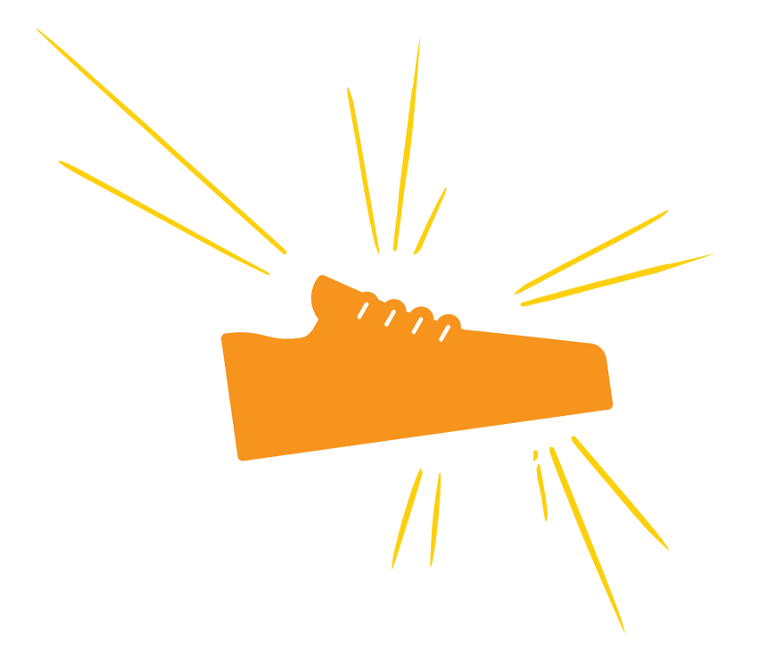
Active Transportation
What is “Active transportation”?
What helps us use active ways to get around?
Walkability: how safe, comfortable, and convenient a place is to walk
Bikeability: how safe, comfortable, and convenient a place is to bike
What makes a place walkable?
Bikeable?
Notes:
‹#›
Speaking notes:
Planning, designing, and engineering transportation is a really important piece of our communities -- especially active transportation planning.
Active transportation includes ways of getting around that are healthy and active such as walking and biking, or activity rolling using skateboards, scooters, etc. that are human-powered.
Active transportation planning is one way to support community members in living healthy lives - with opportunities to socialize with others, build community, and be active.
As we discussed, city planners, engineers, and community members work together to decide how the pieces of their neighborhoods fit together. What “pieces” of a community do you think make a place walkable or bikeable?

Slide 16
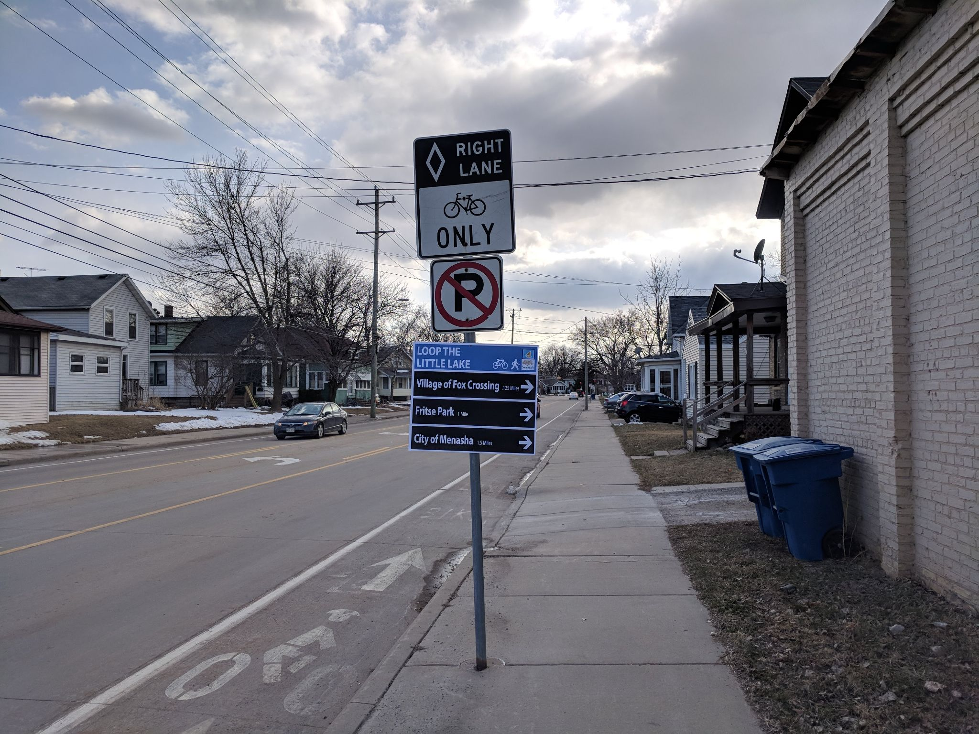
Active Transportation Infrastructure
What is “infrastructure”?
What is active transportation infrastructure?
Notes:
‹#›
Reference the items that students may have listed under walkability and bikeability.
Speaking notes:
Infrastructure can be defined as the resources and physical structures that support an activity or system. Active transportation infrastructure, therefore, are the physical structures that support biking and walking.
Active transportation infrastructure can support:
travel along a roadway or route
sidewalks
bike lanes
trails
traffic calming
travel to a specific destination or across a roadway
crosswalks
curb extensions
dedicated bike or pedestrian signals

Slide 17
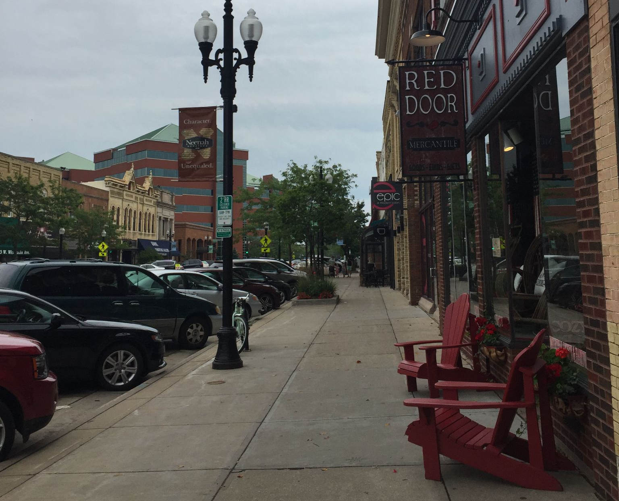
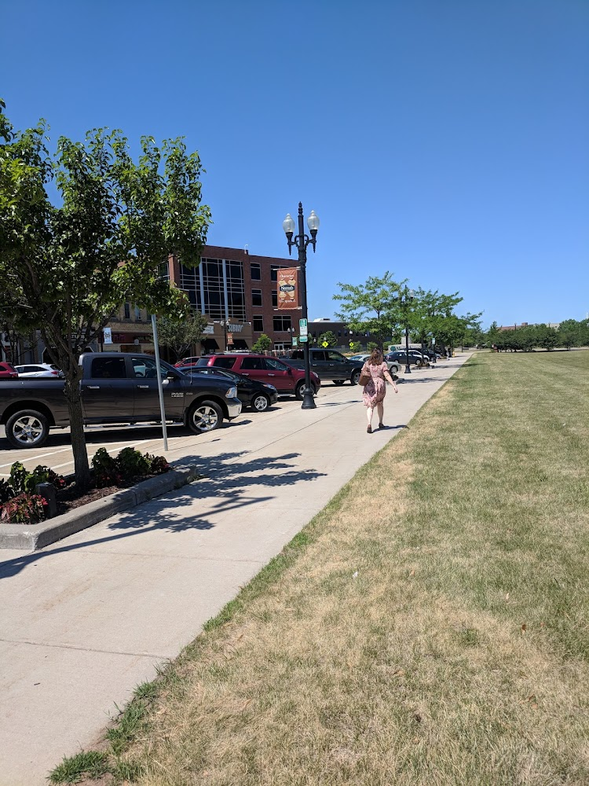
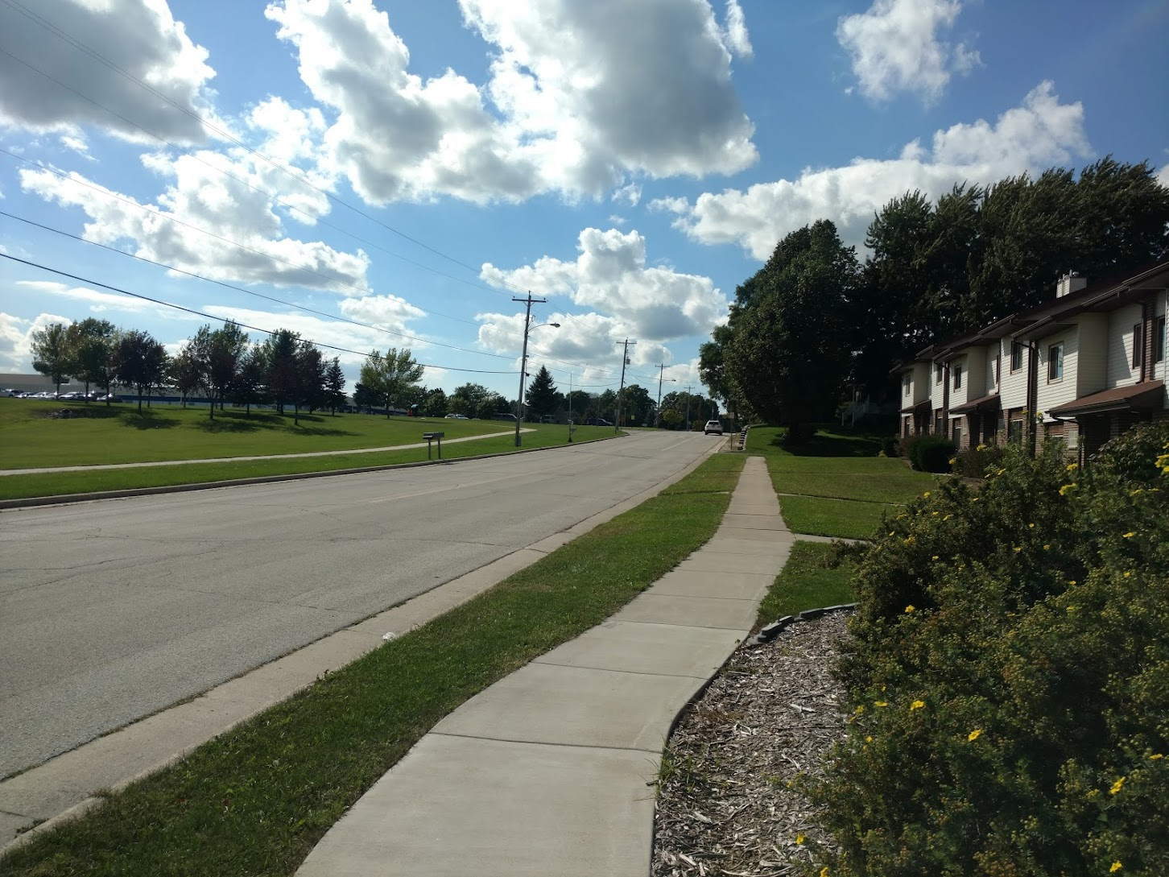
Active Transportation Infrastructure
Sidewalks
Notes:
‹#›
Speaking notes:
Sidewalks are designated places for people to walk, and for people to bike or skate depending on each town’s laws.
Sidewalks provide a safer space for people to walk or run as recreation or as a way to get to and from different places -- but separate from cars and trucks. They make it feel safer or easier to walk to the grocery store or school.
Sidewalks are also great places for people to connect, enjoy local shops or the neighborhood by sitting at a table or a bench.
Photo reference: Taken from Alta ECW Wayfinding project (2017-165)

Slide 18
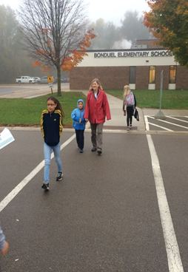
Active Transportation Infrastructure
Crosswalk
Curb Cut / Curb Ramp
Notes:
‹#›
Photo reference: Taken from Project Radar PPT
Speaking notes:
Crosswalks are painted markings that show where people should cross the street. Even if a crosswalk isn’t painted, every intersection is treated as a crosswalk--people walking across the street have the priority.
Crosswalks make people crossing the street more visible to people driving.
Curb cuts provide a small slope or ramp so that the sidewalk or trail is at the same level as the street where people need to cross.
Curb cuts ensure that people of all ages and abilities can safely and comfortably cross the street. This can include people using wheelchairs and strollers.

Slide 19
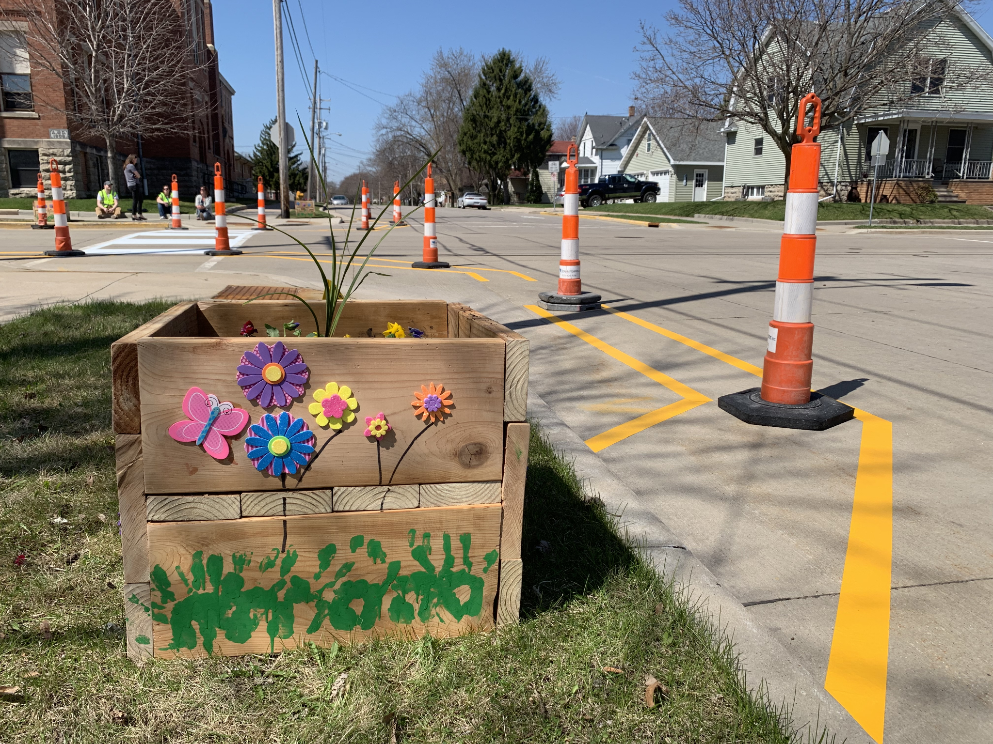
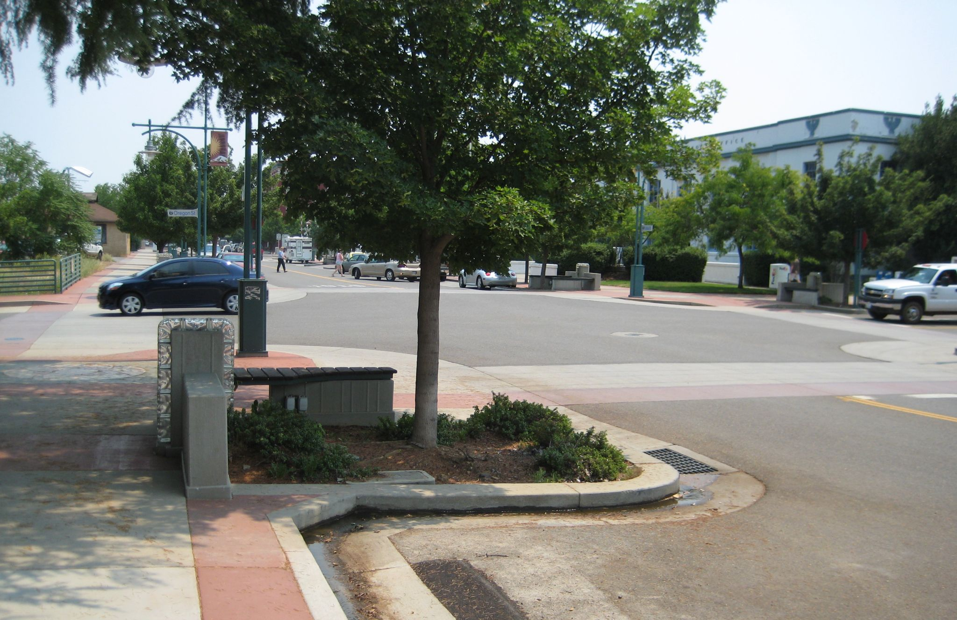
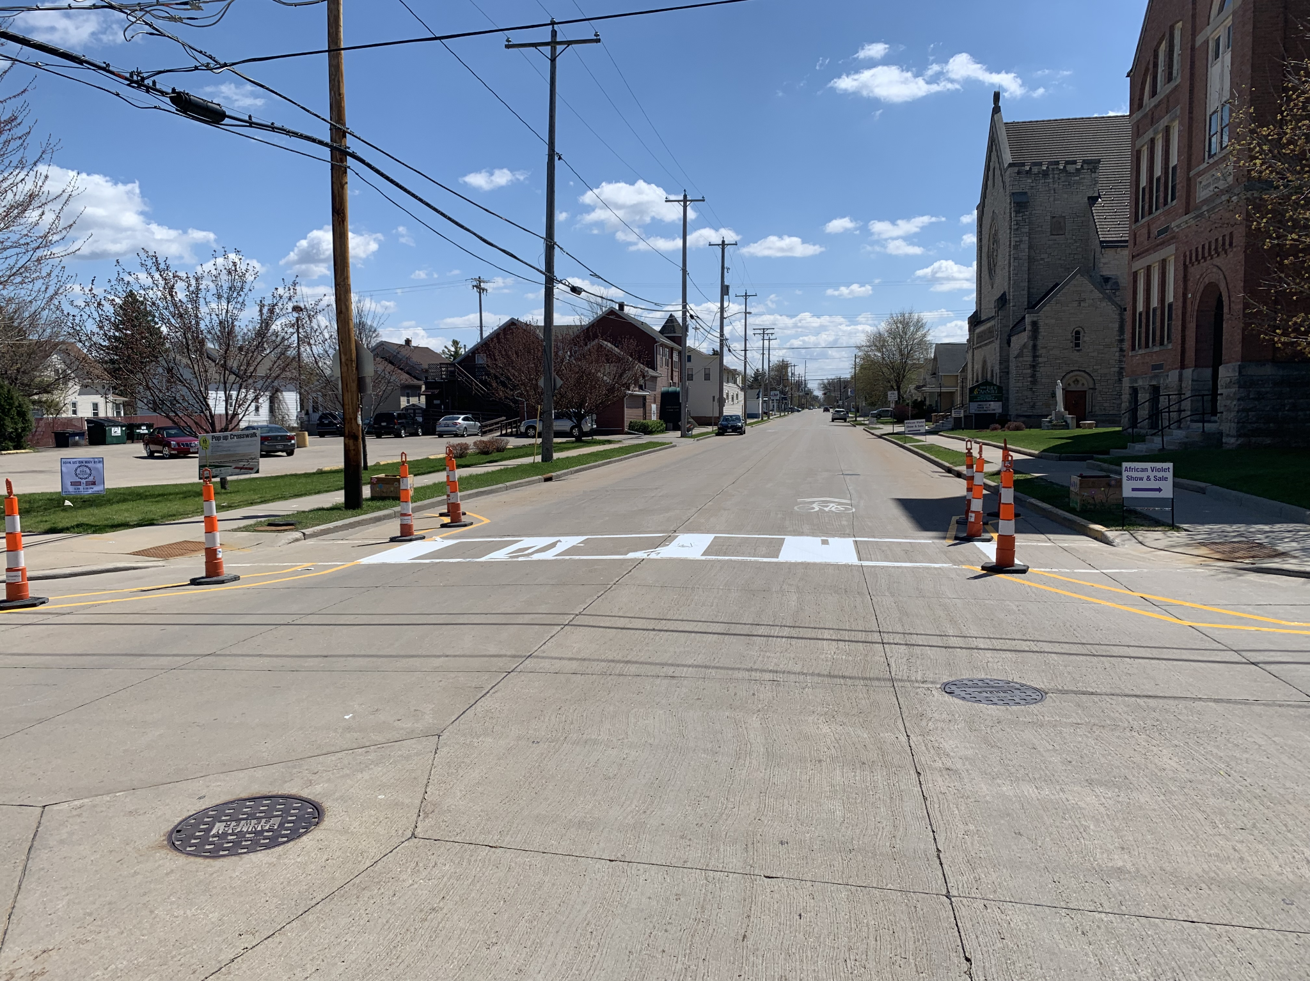
Active Transportation Infrastructure
Curb Extensions
Notes:
‹#›
Photo credits: Alta Planning + Design
Speaking notes:
Curb extensions widen the curb or sidewalk at intersections or sometimes in the middle of the block where people would like to cross the street.
Like speed humps, curb extensions are another form of traffic calming.
Curb extensions aim to:
slow drivers down
make people crossing the street more visible to people driving
shorten the distance that people have to walk to cross the street
Curb extensions can also provide more space for plants and trees!

Slide 20
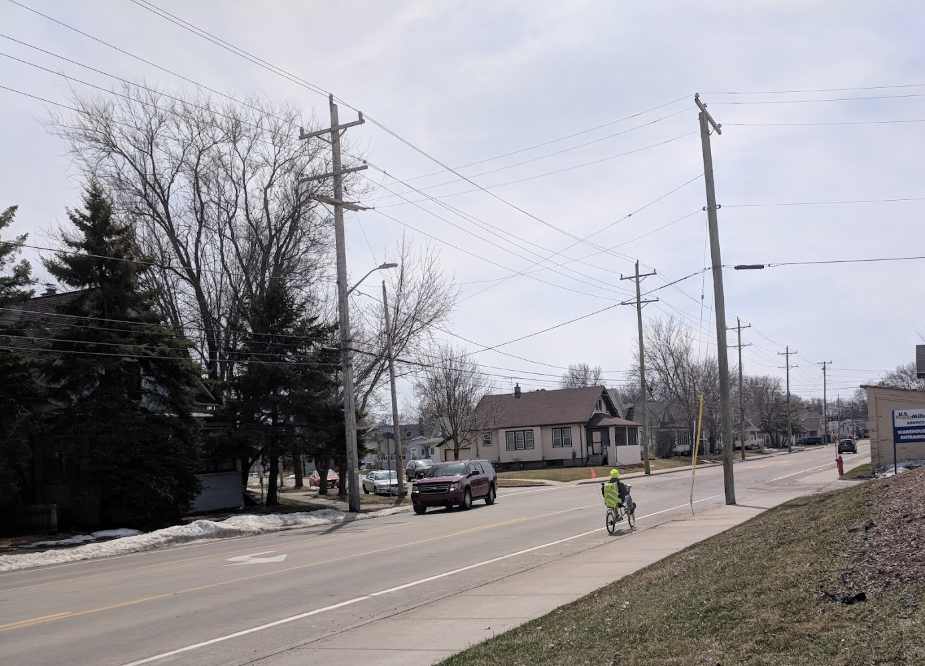
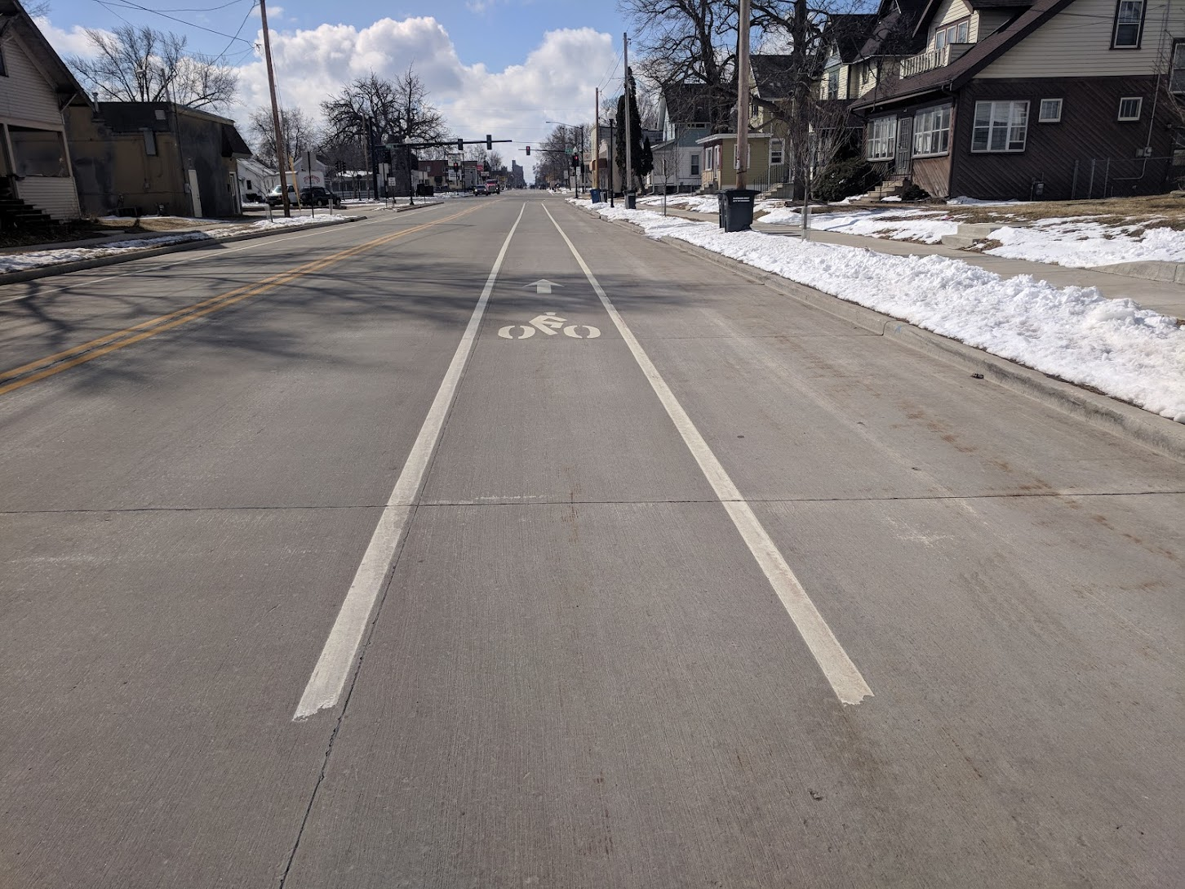
Active Transportation Infrastructure
Bike Lanes
Notes:
‹#›
Photo reference: Taken from Project Radar PPT
Speaking notes:
Bike lanes are designated places on the roadway for people to bike. There are different types of bike lanes, as shown above. Standard bike lanes utilize just 2 painted lines. Separated bike lanes are physically separated from car traffic. Buffered bike lanes are separated from car traffic with a couple of extra feet of painted striping.
Bike lanes provide a safer space for people to bike for recreation or as a way to get to and from different places -- but separate from cars and trucks.

Slide 21
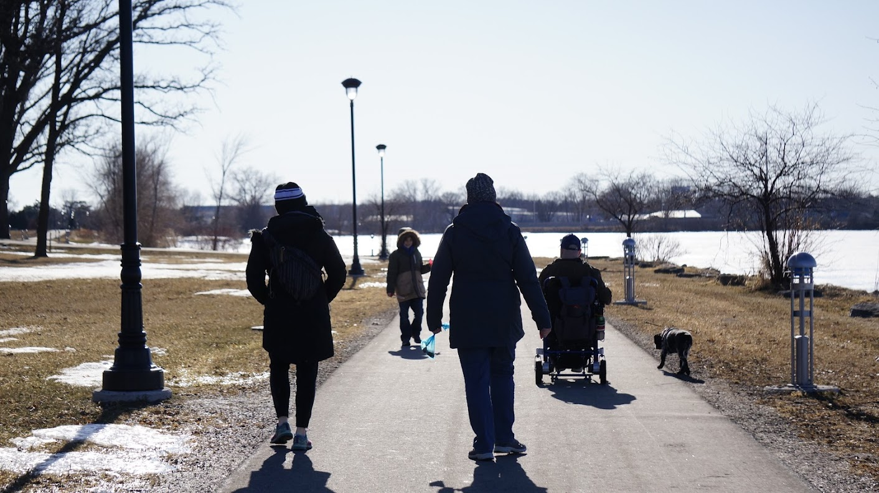
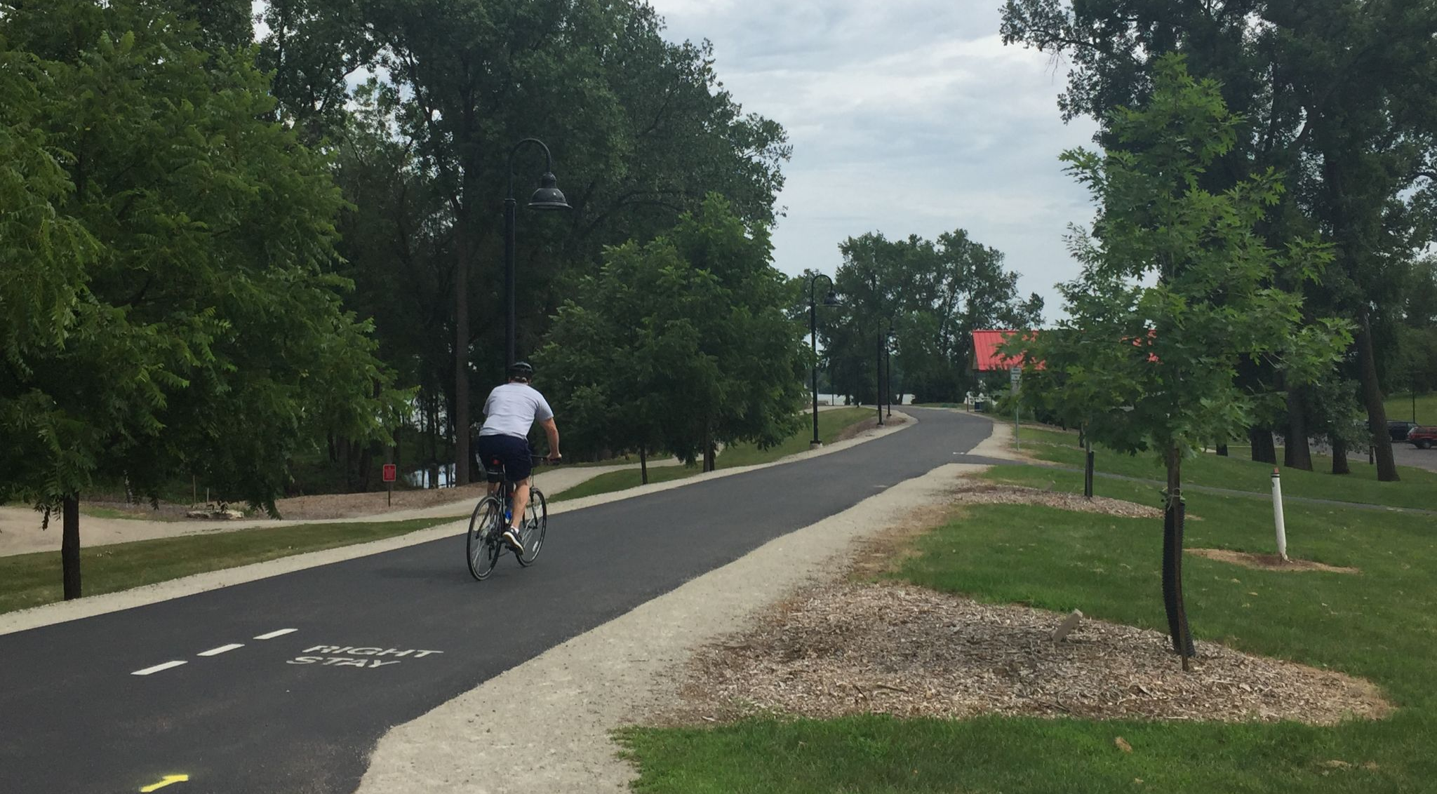
Active Transportation Infrastructure
Trail / Multi-use Path
Notes:
‹#›
Photo reference: Taken from Alta ECW Wayfinding project (2017-165)
Speaking notes:
Trails, also called multi-use paths, are designated places for people to bike, walk, or skate completely separated from the roadway. Trails can be next to the roadway, railroad tracks, or through parks in nature.
Trails are great places to safely and comfortably:
be active
enjoy nature
travel to different places

Slide 22
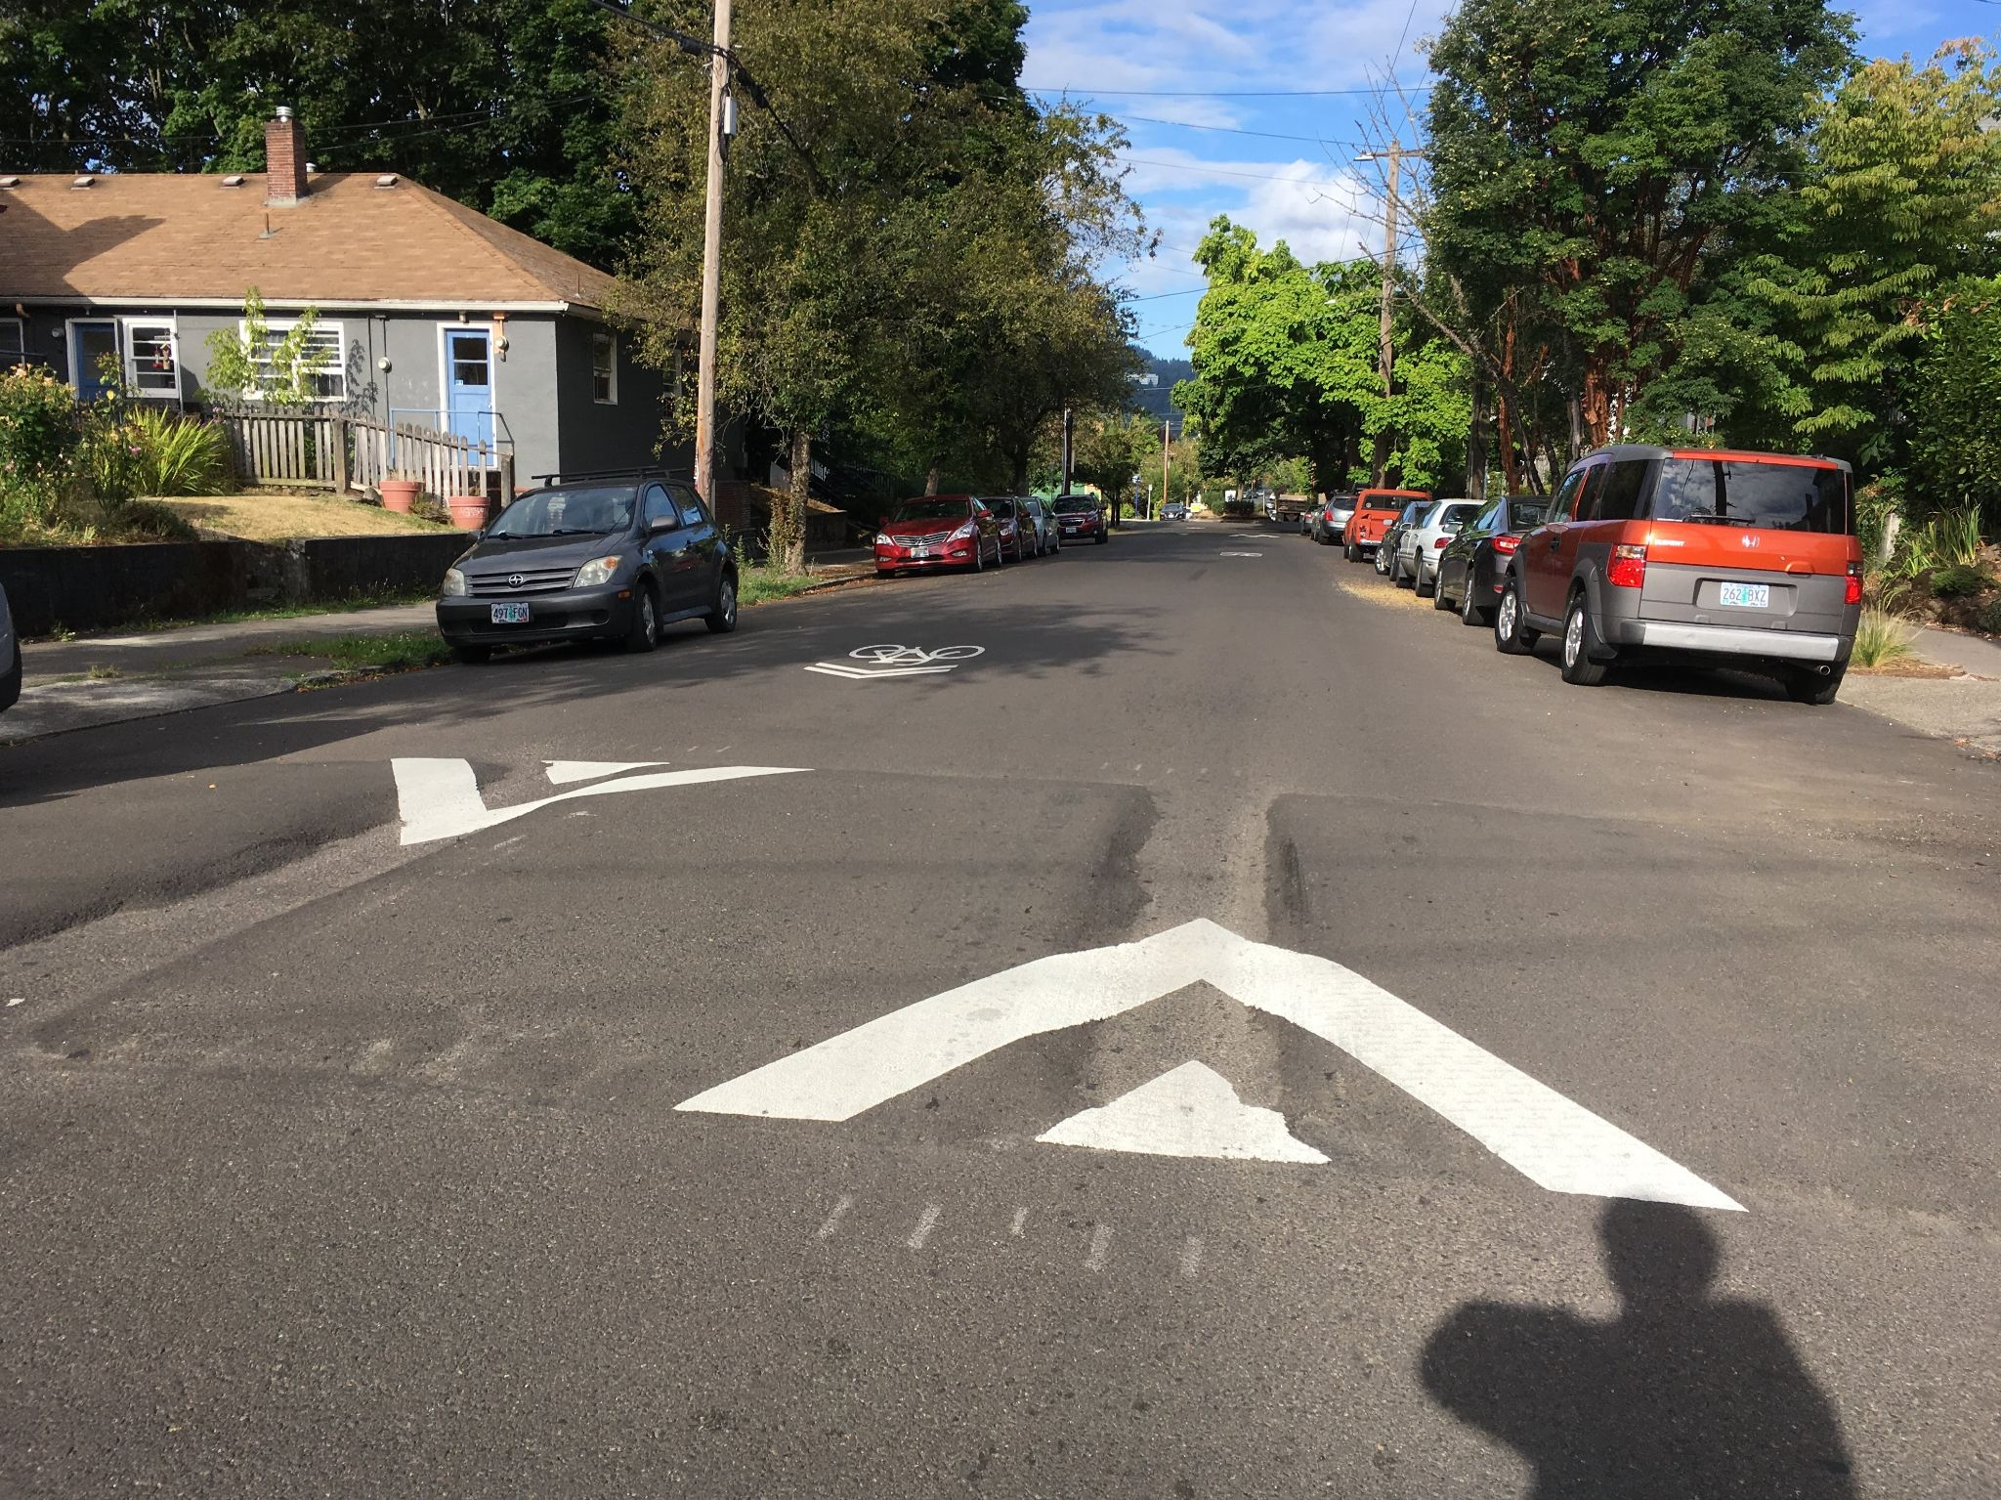
Active Transportation Infrastructure
Traffic Calming
Notes:
‹#›
Photo credit: Alta Planning + Design
Speaking notes:
Traffic calming are types of active transportation infrastructure that encourage people driving to slow down. Perhaps the most common form of traffic calming is speed humps, as shown here, as well as curb extensions.
By slowing down cars, traffic calming can make a street feel safer and more enjoyable to walk or bike to school, the store, or your friend’s house!
When cars drive more slowly, people driving can more easily see and react to people walking and biking.

Slide 23
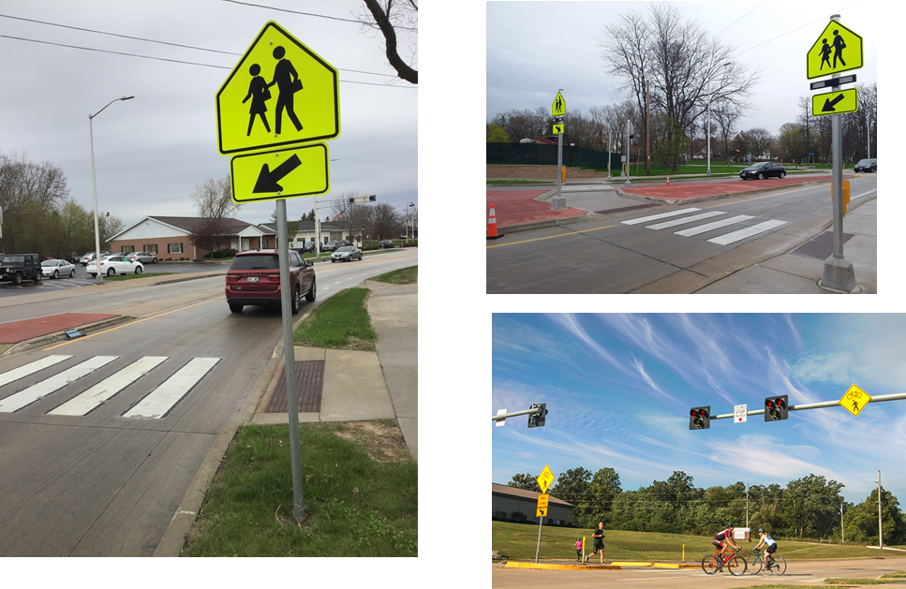
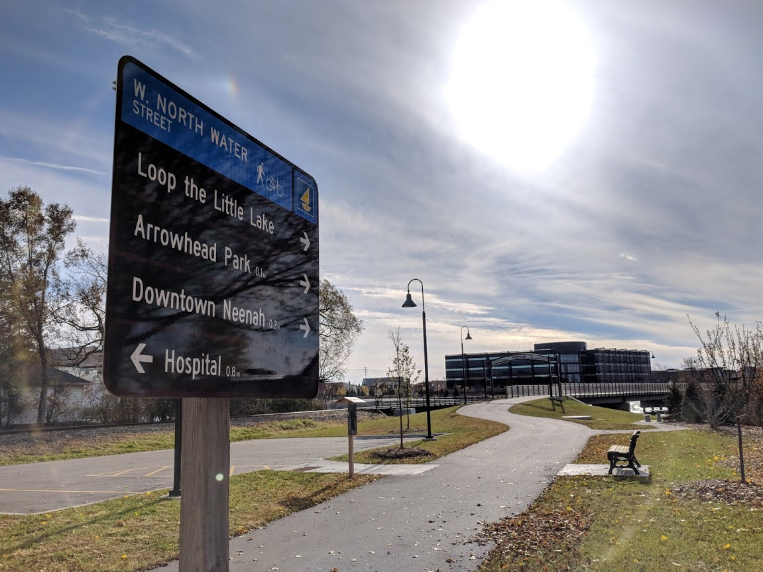
Active Transportation Infrastructure
Signals
and
Signage
Notes:
‹#›
Photo reference: Photo Taken from Project Radar PPT
Speaking notes:
Pedestrian signs warn drivers that people may be crossing the street at that intersection. Sometimes these signs can be activated with flashing lights by pressing a button.
Like crosswalks and curb extensions, pedestrian signs make people crossing the street more visible to people driving. In fact, pedestrian signs often accompany crosswalks and sometimes curb extensions at the same location to make it safer and more comfortable for people to cross the street.

Slide 24
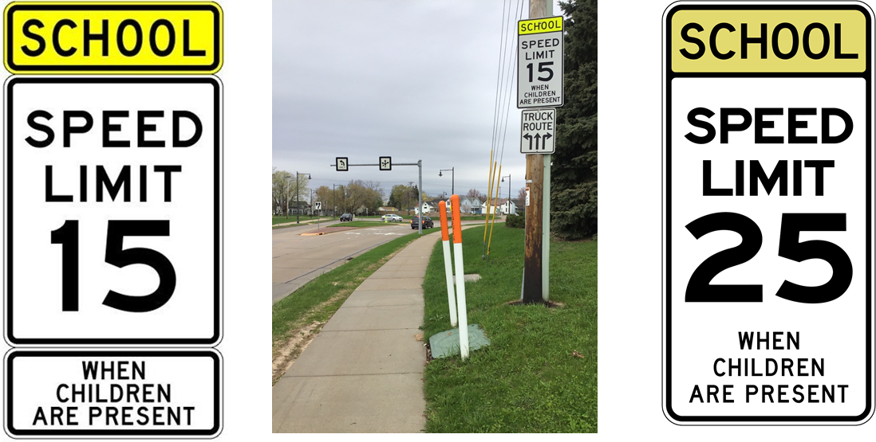
Active Transportation Infrastructure
School Zone Speed Limit Signs
Notes:
‹#›
Photo reference: Photo Taken from Project Radar PPT
Speaking notes:
School zone speed limit signs tell drivers the speed they need to drive when children are present. The speed limit is typically between 15 and 25 mph.
When cars drive more slowly, people driving can more easily see and react to people walking and biking.

Slide 25
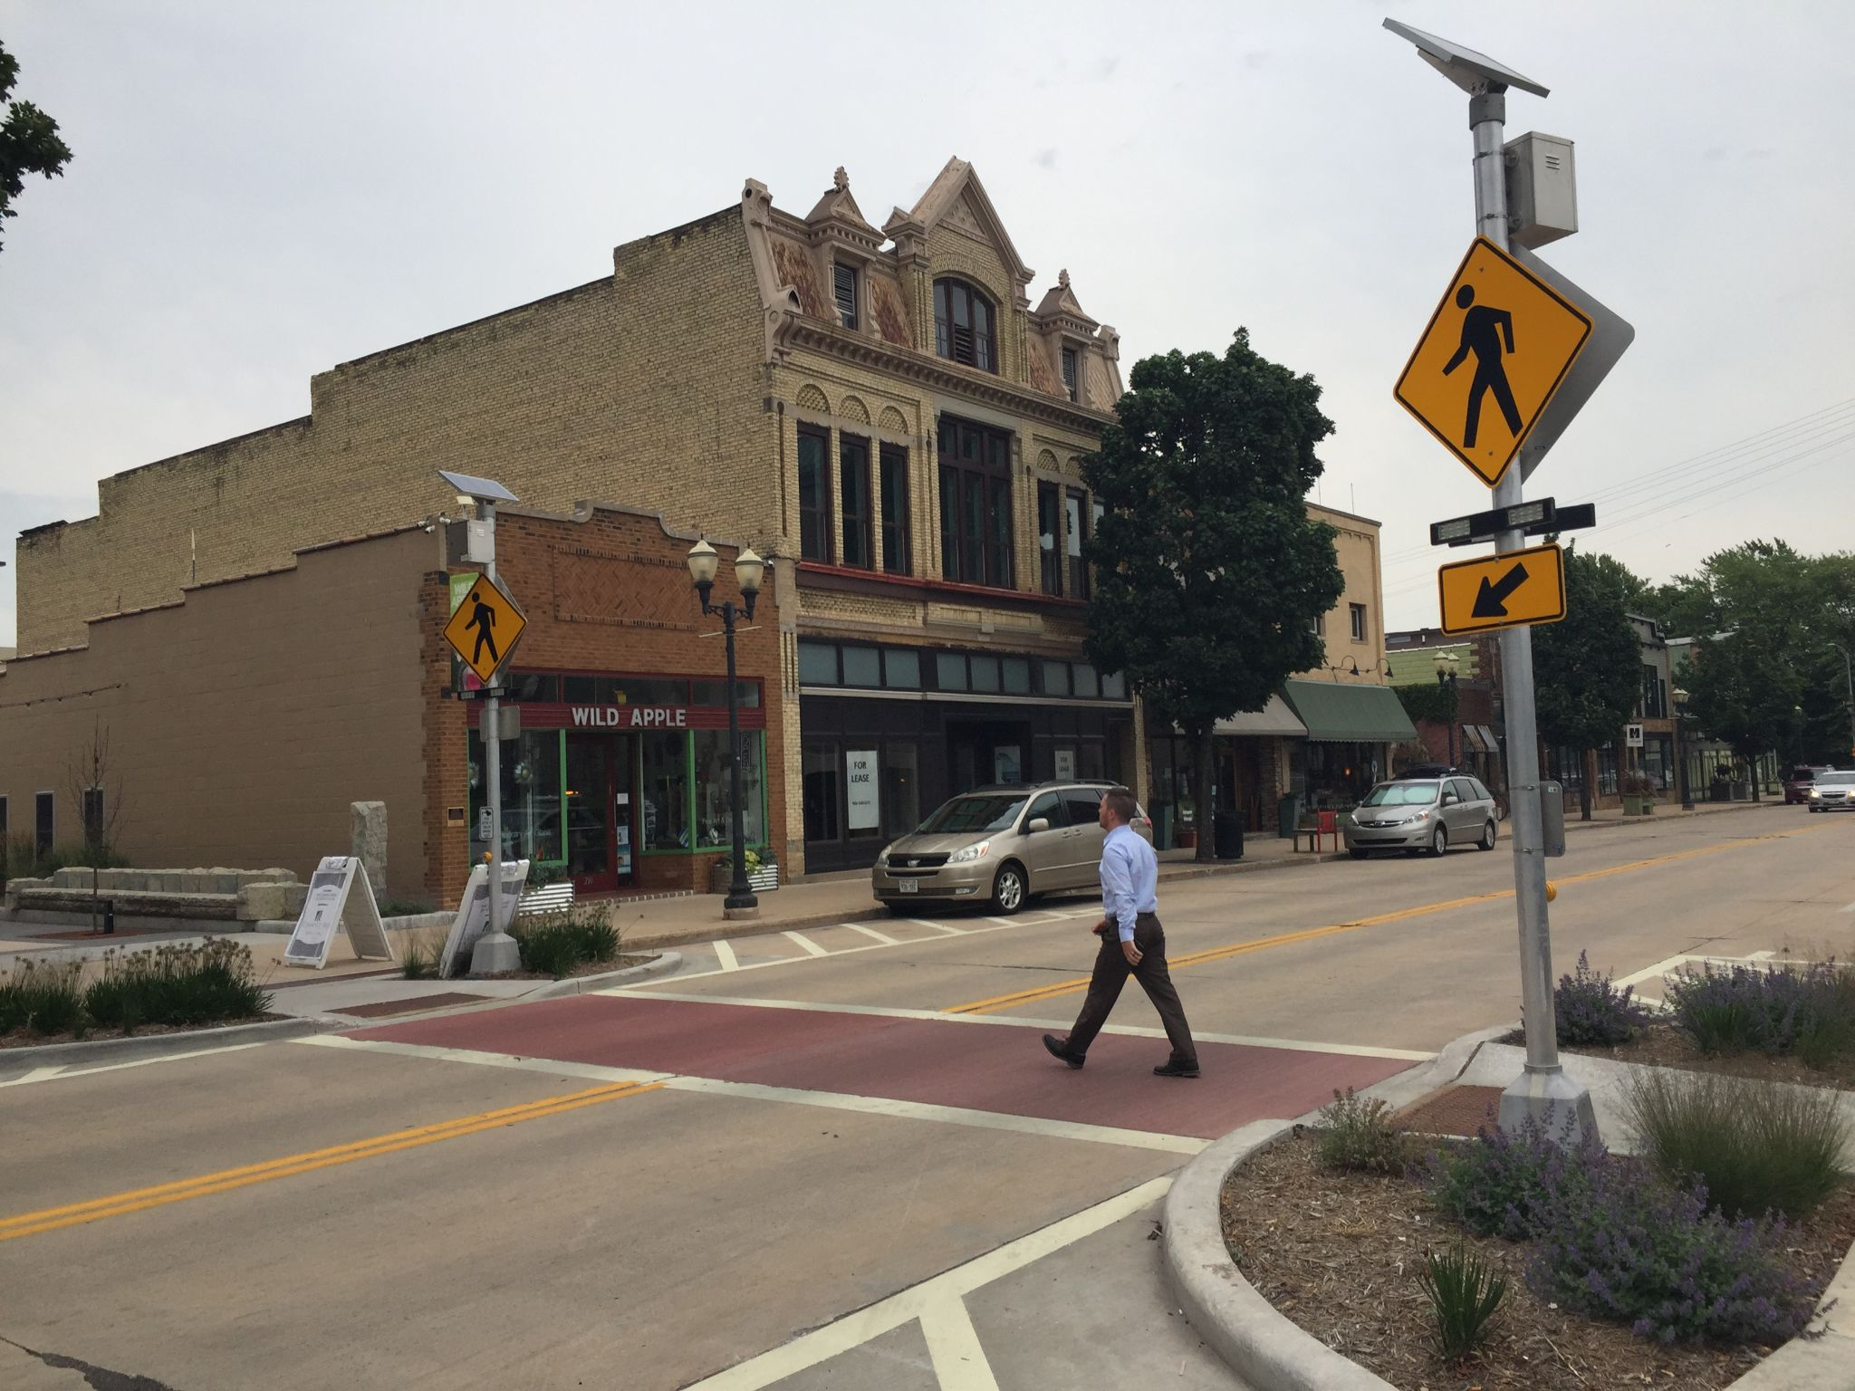
Active Transportation Infrastructure
Pedestrian Lighting
Pedestrian sign (activated with flashing lights)
Crosswalk
Curb cut / ramp
Curb extension
Notes:
‹#›
Photo reference: Photo taken during ECW Regional Trail Wayfinding Guidebook project
Speaking notes:
This photo shows a few types of pedestrian infrastructure at the same location: a curb extension, crosswalk, curb ramp, pedestrian sign, and pedestrian lighting.
These types of infrastructure work together make it safer and more comfortable to walk and cross the street.

Slide 26
Day 1: Solo Reflection
Take a walk in your neighborhood this week and think about:
What active transportation infrastructure is available in your neighborhood? If there is none, think about why there is none.
What modes of transportation does the infrastructure support?
Remember: a mode of transportation = a way that you and your family get around (walk, bike, skate, bus, car, ski, etc.)
What encourages you to use active transportation?
Notes:
‹#›
Optional reflection activity for students to do at home. If you wish to provide homework, they can write a few sentences for each. Otherwise, we encourage students to take a walk and just think about what is in their neighborhood.

Slide 27
Day 2: Route Planning
Learning Objectives:
Learn how to observe the physical built environment and see how the built environment affects physical mobility, connectivity, access to resources, wellness, and transportation choices. (Environmental Literacy and Sustainability, Standards 1, 3, 6; Health Standards 1, 2)
Identify or compare built environment areas in the community that promote well-being and explain why, and the impacts on society. (Environmental Literacy and Sustainability, Standards 1)
Apply the knowledge about the connection between the physical built environment, social environment, and planning to plan a route to school. (Environmental Literacy and Sustainability, Standards 1, 6)
Logistics:
Time: 30-45 minutes
Three options:
Outdoor walk audit (slide 32)
In-classroom digital walk audit (slide 30)
In-classroom print walk audit (slide 31)
Materials:
Outdoor walk audit (slide 32):
Permission slips
Printed activity sheets
In-classroom digital walk audit (slide 30)
Computers/tablets with Wi-Fi connectivity and large screens
In-classroom print walk audit (slide 31)
Drawing materials for each small group
Printed images near the school campus
Notes:
‹#›
Slide for educator

Slide 28
Day 2: Route Planning
In-Classroom Walk Audit - Options
Digital Option:
Students work in small groups using Google Maps to find their school and use Google Street View to “walk” one or two blocks from the school.
As they “walk,” they examine the roadways, sidewalks, crossings, and signs.
They identify locations that are missing infrastructure that could make it feel safer to walk or bike.
They take screenshots of these areas and digitally sketch how they would make improvements.
Paper Option:
Students work in small groups using printed aerial and street view maps zoomed into one or two blocks from school. The street view maps should feature active transportation infrastructure or missing infrastructure for them to examine.
As they follow the roads, they examine the roadways, sidewalks, and crossings.
They identify locations that are missing infrastructure that could make it feel safer to walk or bike.
They sketch on the paper maps how they would improve these areas.
Notes:
‹#›
Slide for educator

Slide 29
Day 2
Route Planning & Walk Audit
How do we figure out which streets to use to get where we want to go? How do we encourage making our streets safer?
Notes:
‹#›
Introduction slide to student content, day 2

Slide 30
Day 2: Route Planning
Walk Audit Overview
What is a route?
What is a walk audit?
Why do a walk audit?
How are the results used?
Notes:
‹#›
Speaking notes:
A route is the direction--in our case, streets--that a person chooses to travel to get from one place to another.
A walk audit brings people in a community together to observe the walkability of an area. During a walk audit, the group will observe:
whether or not there is active transportation infrastructure
the condition of that infrastructure (such as whether or not a sidewalk is cracked)
areas or locations that feel unsafe or uncomfortable to walk
A walk audit helps the community understand the challenges to walking, the opportunities to improve walking, and the best routes for walking.
The results can be used to:
choose a route to school or other destination
tell planners and engineers where improvements can be made for walking

Slide 31
Day 2: Route Planning
In-Classroom Walk Audit - Digital
Activity Instructions:
In your small group, use Google Maps to type in our school name or start a “Google My Maps” and type in our school name.
Use Google Street View to explore at least 1 full block from the school.
As you explore the block using Google Street View, examine the road, sidewalks, crossings, signs, and anything else you notice that might make it feel more or less safe to walk and/or bike.
Using either Google My Maps or copy of the aerial view, mark on the map where you see infrastructure that supports walking and biking.
Identify at least two locations that might not feel as safe to walk or bike. They could either be missing active transportation infrastructure or the existing infrastructure could be improved. Note these on the map and explain why or how they could be improved.
Take screenshots of the locations with good active transportation infrastructure and places where improvements are needed.
Insert at least one of the screenshots into Microsoft Paint.
Digitally sketch how you would make improvements for walking or biking.
Notes:
‹#›
Instructions to students, consider projecting on the wall for continual reference

Slide 32
Day 2: Route Planning
In-Classroom Walk Audit - Paper
Activity Instructions:
In your small group, use the printed large aerial map to locate our school and identify the street names that connect with and surround the school.
Take the printed street view maps and identify where these images are located on the large aerial map.
Examine the infrastructure in the street view maps, looking at the road, sidewalks, crossings, signs, and anything else you notice that might make it feel more or less safe to walk and/or bike. Where there is missing infrastructure and it could make someone walking or biking feel unsafe, sketch on at least one street view map, how you would make improvements.
Mark on the large aerial map where you see active transportation infrastructure exists and where you are proposing changes.
Bonus: Based upon your review of one or more blocks near school, identify which street you would choose as your walking or biking route to school.
Notes:
‹#›
Instructions to students, consider projecting on the wall for continual reference

Slide 33
Day 2: Route Planning
Outdoor Walk Audit
ECW to provide details on this slide + provide the Walk Audit worksheet
Notes:
‹#›
ECW to add speaking notes

Slide 34
Day 2: Route Planning
Additional Activities!
After students work through the in-classroom walk audit or outdoor walk audit, here are two optional activities:
Ask students to assess the streets between their school and home or a popular location near school.
What route would they plan to walk from school to that location?
What route would they want to bike along to school from that location?
Ask students to look at the streets surrounding where they went to Elementary School.
How would they plan a Walking School Bus route for groups of young students along a 5-6 block route?
Where would they locate safe places for the “Bus Stops”?
Notes:
‹#›
Slide for educator

Slide 35
Day 3: Presentations!
Learning Objectives:
Identify changes and processes for affecting change in their environment (Environmental Literacy and Sustainability, Standards 6, 7)
Logistics:
Time: 30-45 minutes
Students can prepare a presentation about one or more of the following:
Group presentations about their planning and design improvements that discuss:
(1) the existing infrastructure they found and how it supports walking and biking,
(2) the places missing infrastructure, and
(3) what infrastructure ideas from Day 1 they would use to improve it.
A topic they really enjoyed learning about
Materials:
Powerpoint presentation or poster board presentation
Encourage students to invite a local planner to their presentations or share their report with city council
Notes:
‹#›
Slide for educator

Slide 36
Questions or Feedback?
Reach out to the Safe Routes to School team at the East Central Wisconsin Regional Planning Commission:
eastcentralsrts.org/about-us/contact-us
Join in one or more of our many flagship events, including:
Walk & Roll to School Days
Walking School Bus program
and local challenges!
Notes:
‹#›
Slide for educator

